Slide 1
Mines, Minerals, and Minecraft
Dr. Charles “Chuck” Bell
Lesson 3: 06 February 2019

Slide 2
Agenda
Bible Study: 10-15 minutes
The Raspberry Pi: 5-10 minutes
Hacking Minecraft with Python: 30-45 minutes
Introduction to Programming Minecraft
Example Project: Finding and Teleporting Steve

Slide 3
Bible Study
Metals in the Bible

Slide 4
Metals in the Bible
Precious metals played a very important role in the Bible.
Some metals had special meaning appended to them.
Gold: Divine Nature
Silver: Spirit Nature
Copper: Human Perfection
Wood: Imperfect Man (wood is corruptible)
These materials were found in one of the most profound objects in the Old Testament – the Tabernacle

Slide 5
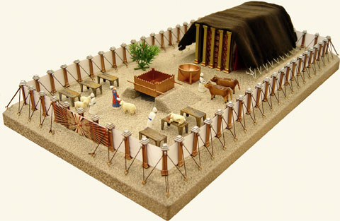
Tabernacle

Slide 6
Materials
Hebrew word meant “tent”
Very costly, expensive, portable
Acacia wood structure (sometimes call shittim)
Covered with much gold, silver, bronze/copper
Specially woven coverings of expensive blue, purple and scarlet cloth, fine linen
Goat hair, ram skin, badger or seal skin

Slide 7
Components
Tent and coverings, curtains (veil)
Outer wall with one gate
Fire pit for offering (altar)
Brazier for incense (altar)
Ark of the Covenant
Menorah (candlestick)
Table for bread

Slide 8
Courtyard
Size was approximately 150’ X 75’ X 7.5’
The Tabernacle itself was twice as high, so it could be seen outside the courtyard.
Courtyard walls made of finely woven white linen.
Suspended from silver rods and silver hooks, on posts set in bronze sockets.
20 posts/sockets on north and south, 10 on east/west.
Held by bronze pegs and ropes with silver rings.
Courtyard entrance on east side, with a curtain made like the tabernacle curtain.

Slide 9
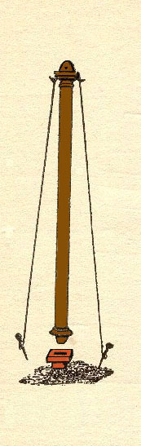
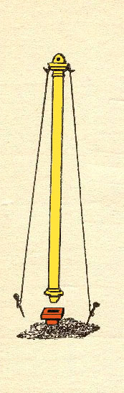
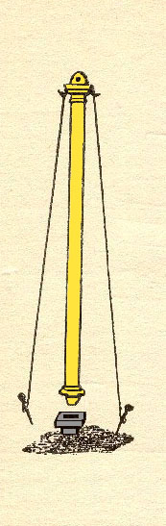
Courtyard Posts
COURT
HOLY
MOST HOLY
Wood
Gold
Gold
Copper
Copper
Silver
Notes:
Why the change? Let’s apply what we learned about wood and metals

Slide 10
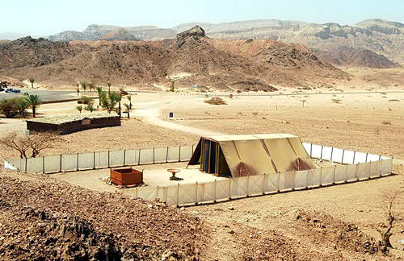
Courtyard

Slide 11
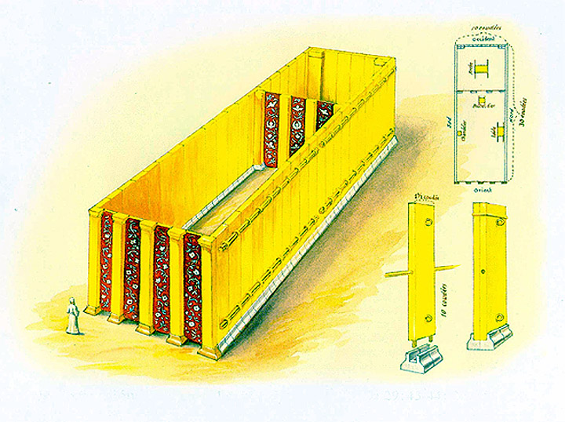
Tent Walls
.
20 boards on north
20 boards on south
8 boards on east
48 total boards
Made of Acacia Wood
Overlaid with Gold
15’
S
15’
N
15’
15’
45’
100 silver sockets
(96 for boards)
(4 for interior posts)
Wt. 75 pounds
27”

Slide 12
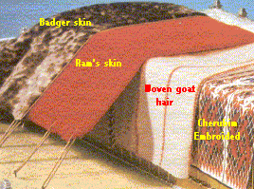
Tent Coverings
Innermost: Fine linen, white, with cherubim woven with blue, purple and scarlet
2nd: Goats hair (possibly black)
3rd: Rams skin
Outer: Skin of Seal, Porpoise
Held in place by pegs and ropes.
No mention of a ridge pole to provide a peak.

Slide 13
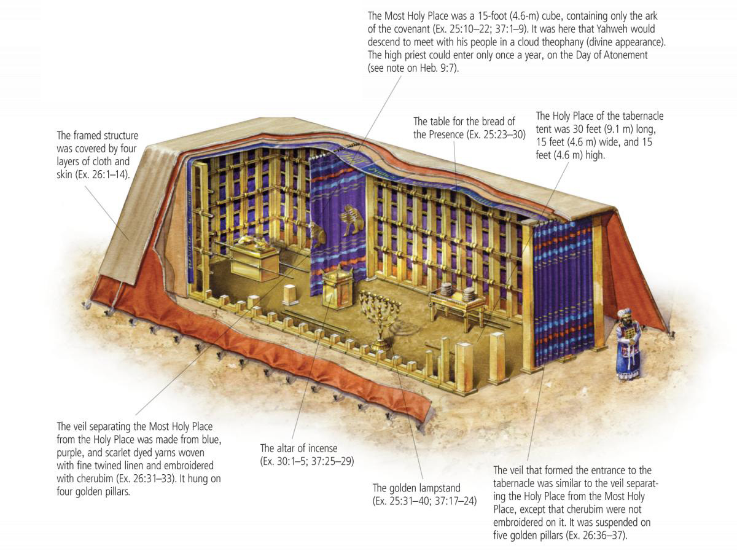
Layout

Slide 14
Ark of the Covenant
The Ark was made of acacia wood and overlaid with gold, inside and out with a gold crown or molding set around the edge of the top.
Four gold rings, one on each leg, were placed for the carrying poles.
The poles were acacia wood overlaid with gold.
The Mercy Seat was set on top of the Ark.

Slide 15
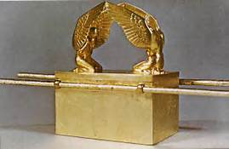
Ark of the Covenant

Slide 16
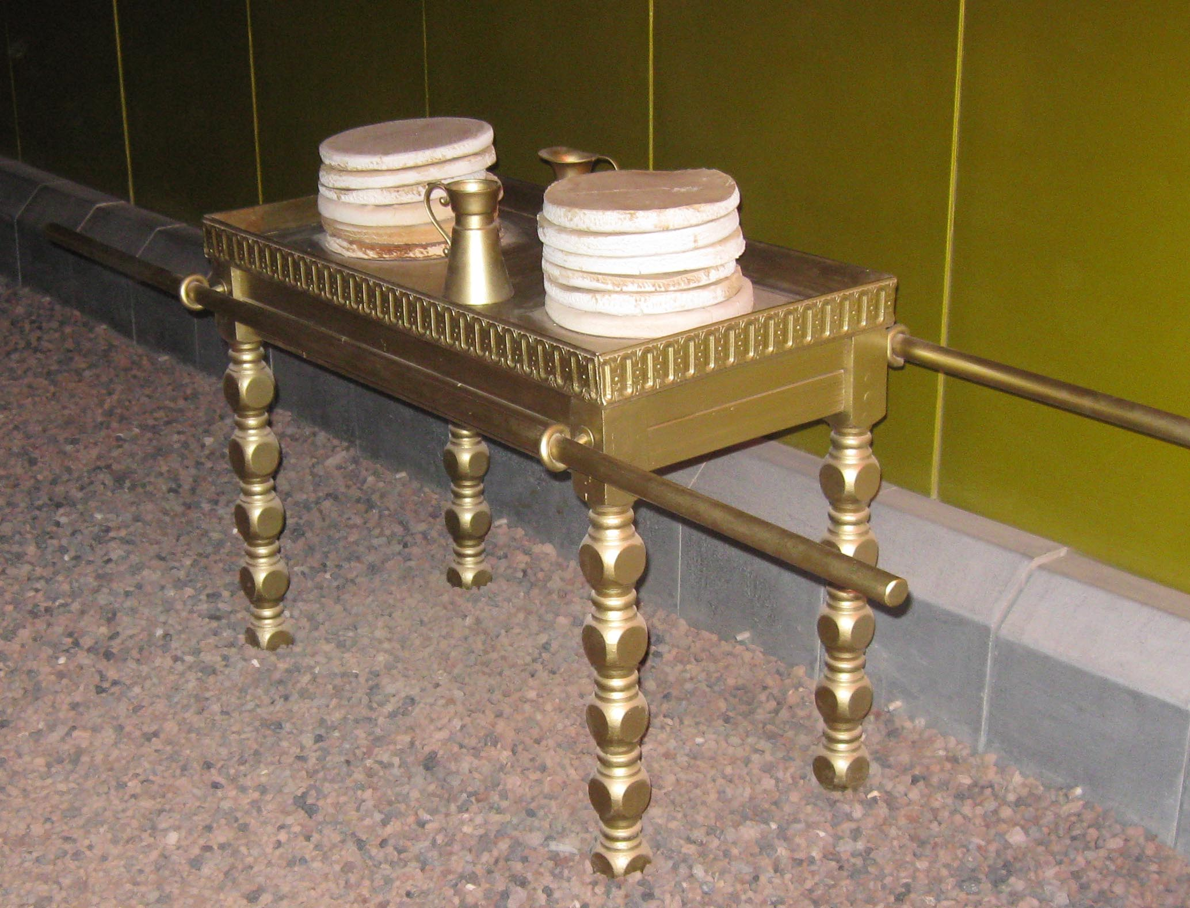
Table of Showbread
Made from acacia wood, and only covered with pure gold, with a gold border around the top.

Slide 17
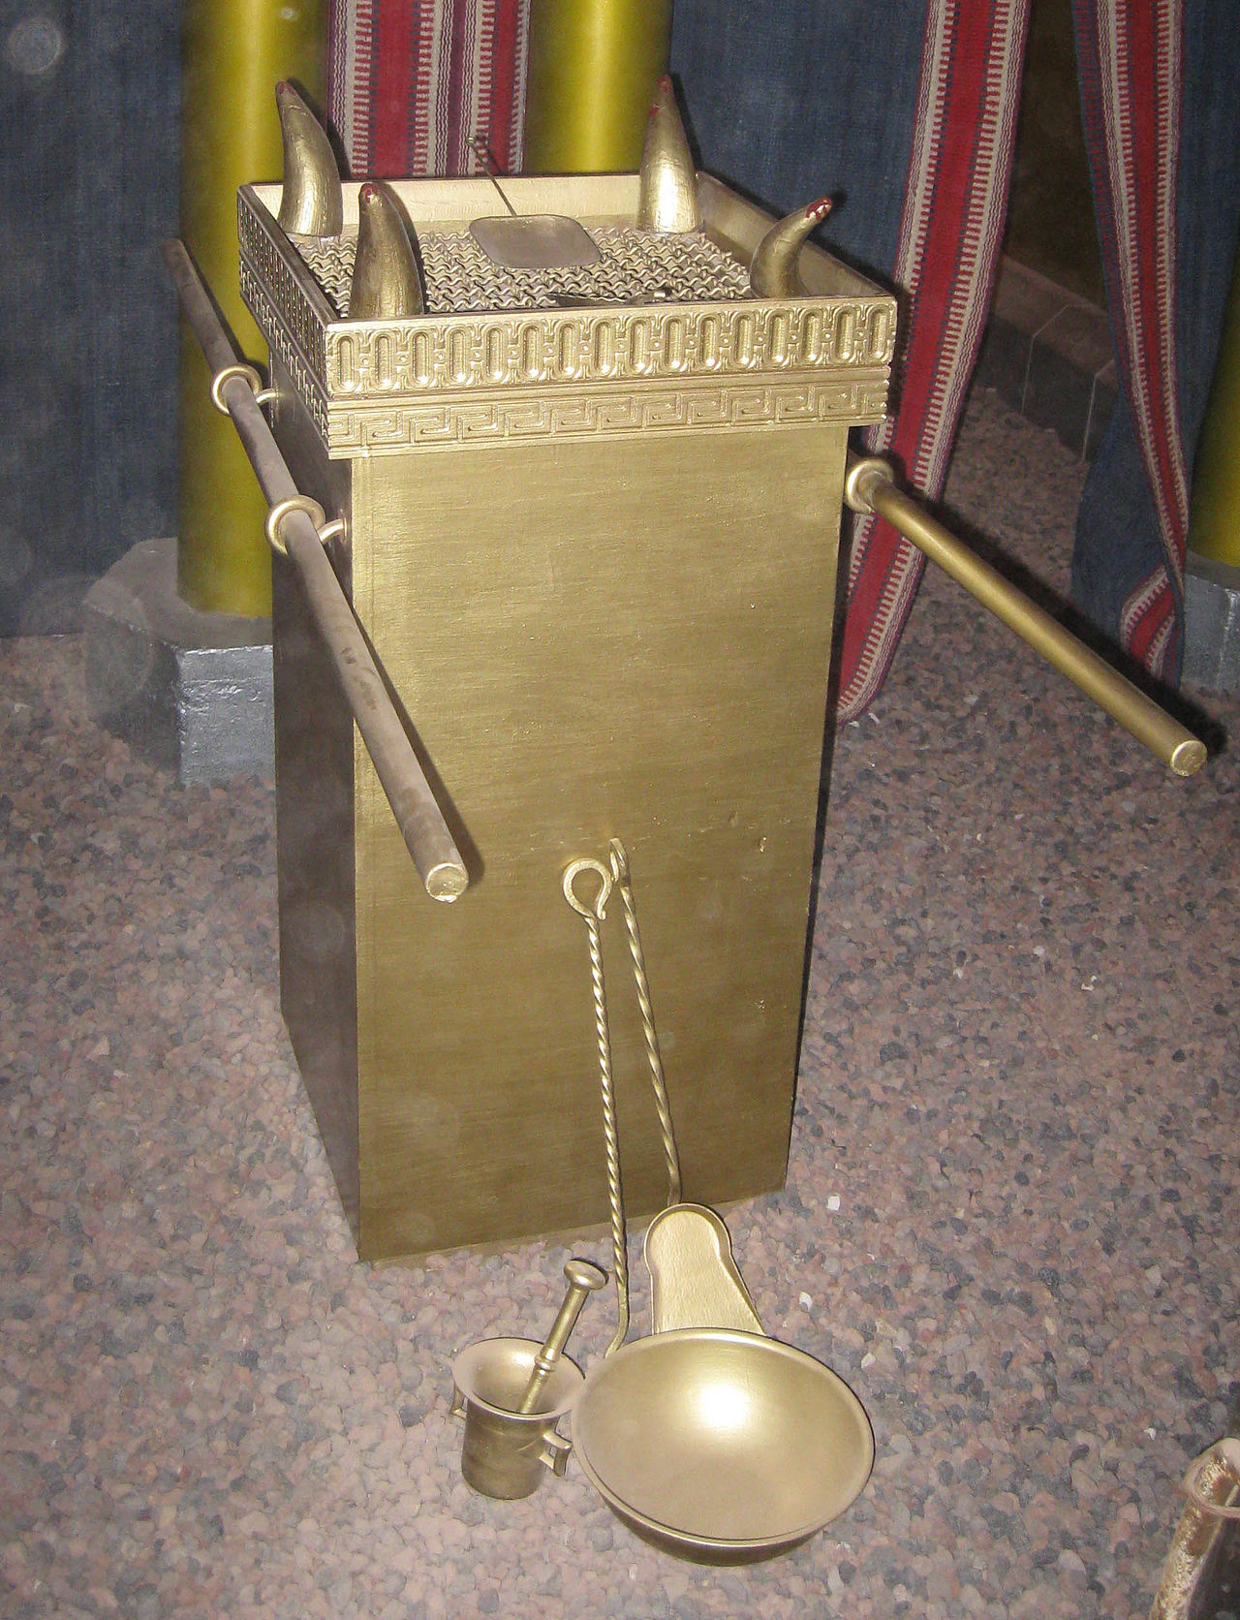
Altar of Incense
Also the Golden Altar
Made from acacia wood and covered in pure gold.
It was an upright rectangular stand with a "horn" on each corner, a border of gold around the top, and rings on opposite sides through which poles could be passed to carry it.
The poles were made of acacia wood covered with gold.
Moses consecrated the altar with the anointing oil when the Tabernacle was dedicated (Exodus 40:9).

Slide 18
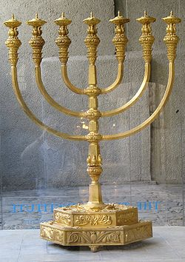
Golden Lampstand
Made from a solid block of gold.
Had 7 oil lamps (not candles) on top.

Slide 19
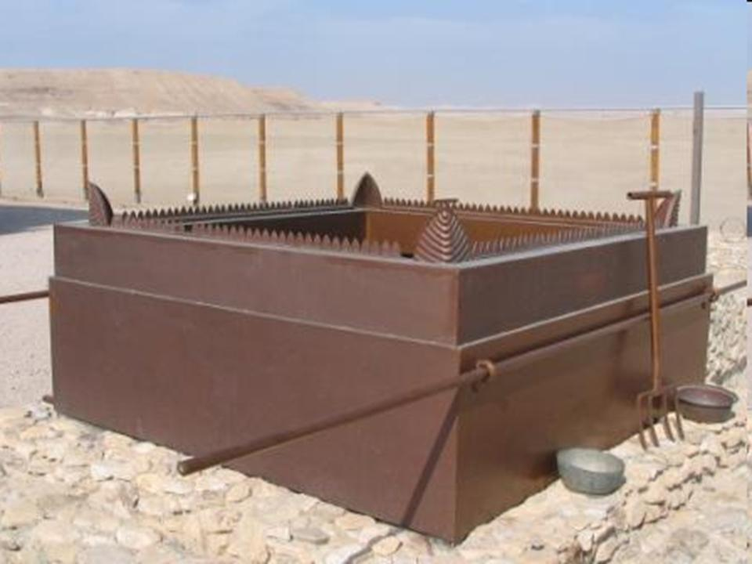
Bronze/Brazen Altar
Also called the Altar of Burnt Offerings
Large, made from bronze (some say copper)
Located in the courtyard

Slide 20
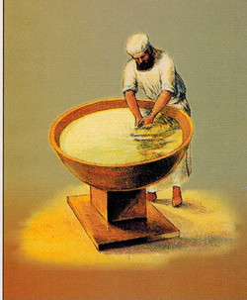
Laver
Both the laver and its base were to be made of bronze.
Bronze mirrors supplied by the Israelite women who served at the Tabernacle door were used to make the laver and its base, and they were then anointed with holy oil along with the Tabernacle, all its furnishings and the priests.

Slide 21
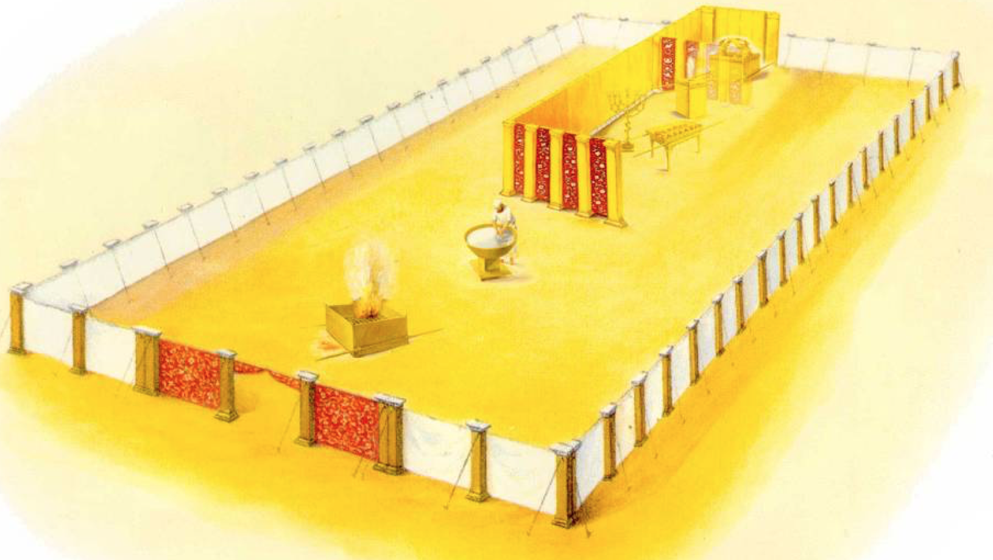
Tabernacle Layout

Slide 22
Precious Metals in the Tabernacle
The Tabernacle was made from a lot of precious metals including gold, silver, bronze, and copper.
By today’s standards, it would take several large trucks to transport it (yet they carried it by hand and oxen).
The cost of the Tabernacle (what it was worth) in today’s money is estimated to be over $1,000,000,000,000.00 USD!
Clearly, God intended the Tabernacle to be a sacred, special place.
Now you know why God says heaven will be paved in Gold – it’s not new, He’s done it with the Tabernacle!

Slide 23
The Raspberry Pi

Slide 24
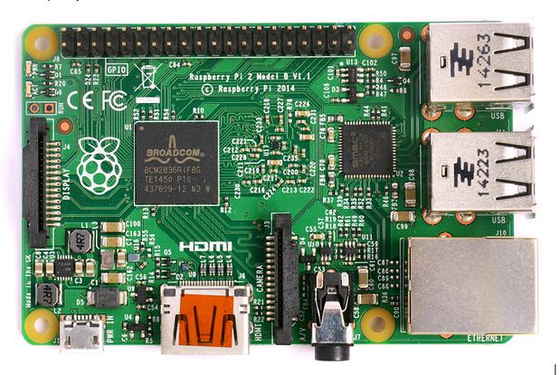
Review
GPIO
MicroSD-slot
(underneath)
4x USB 2.0
Micro USB for power (min. 5V/1A)
Ethernet
3.5mm Audio/Video Jack
HDMI
Camera connector

Slide 25

Commands
raspi-config
Change your pi configuration settings. startx
Start the GUI (Graphical User Interface) ifconfig Get the details of your Ethernet or wireless network adapter. rpi-update Updates your Raspberry Pi firmware. lsusb Shows a list of usb devices. apt-get update & apt-get upgrade Update or upgrade your pi software
ssh
Connect your pi to other computers. sudo
Run commands as super user. shutdown This will shutdown your pi. nano This is your text editor for changing or adding files. Save, edit, create. cat Read out files at the command line. passwd Change your user password.

Slide 26
Commands
ls
List out the current directory files. cd
Go to directory or folder. find Searches whole system for files or directories. clear Clears the terminal screen. mv Move files or folders. rm & rmdir Remove files and remove directories.
touch
Create a blank file. mkdir
Create a directory. ping Test connectivity between two devices. df -h Shows disk space. iwconfig Wireless configuration tool. cp Copy files and folders.

Slide 27
Raspberry Pi 3B+
The latest RasPi 3B+ requires more power!
You must use a 2.5A 5V power supply to power this board.
Easily obtained from Amazon (and others)
Look for CanaKit RasPi 5V adapter

Slide 28
Hacking Minecraft with Python

Slide 29
Get Set…
You will need to arrange 2 program windows on your desktop
Minecraft Pi
Python 2
Python is a programming language you will use to interact with Minecraft (make buildings, show messages, etc.)
Load BOTH programs and arrange your screen like this…

Slide 30
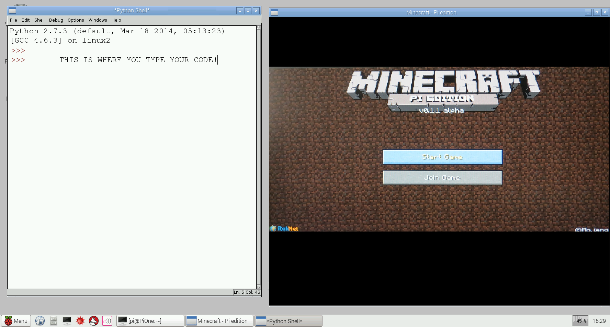
Minecraft & Python Screens
To enter your code, you click FILE and NEW…
To move the mouse out of Minecraft, press the TAB key first

Slide 31
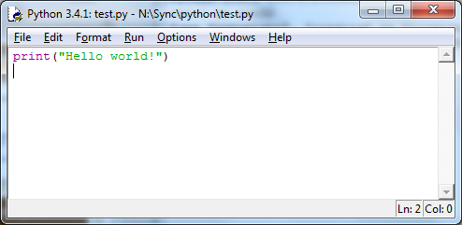
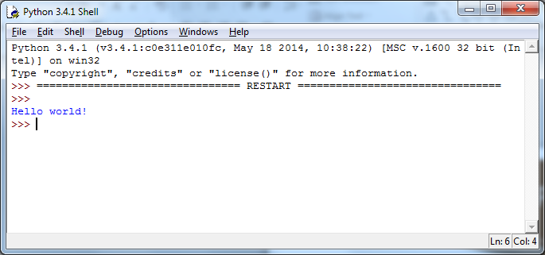
Get the right Python
In Python, you have the window to store the program code AND a window where it runs. You need to type your code into this window

Slide 32
Interacting with Minecraft
We can connect to Minecraft by using Python run externally.
Uses the Python Minecraft application programming interface (API)
We then write scripts (programs) that interact with the Minecraft environment.
We can save them and replay them anytime.

Slide 33
Text Messages
Start a new Python window, by clicking ‘File’ and ‘New.’
Click in your new empty Python window and type this code.
import mcpi.minecraft as minecraft
mc = minecraft.Minecraft.create()
msg = “Hello world”
mc.postToChat(msg)
Click on File and save your code in your Pi ‘Documents’ folder as text.py
Click Run -> Run Module
Try another few. What happens with long sentences?
Capital letters and spaces MUST be correct, or your code won’t work

Slide 34
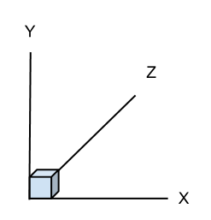
Where am I?
Graphs use X co-ordinates for left-right and Y co-ordinates for up-down.
Minecraft is a 3D game, so also has forwards-backwards movement.
X = Left-Right Y = Up-Down Z = Forward-Backward

Slide 35
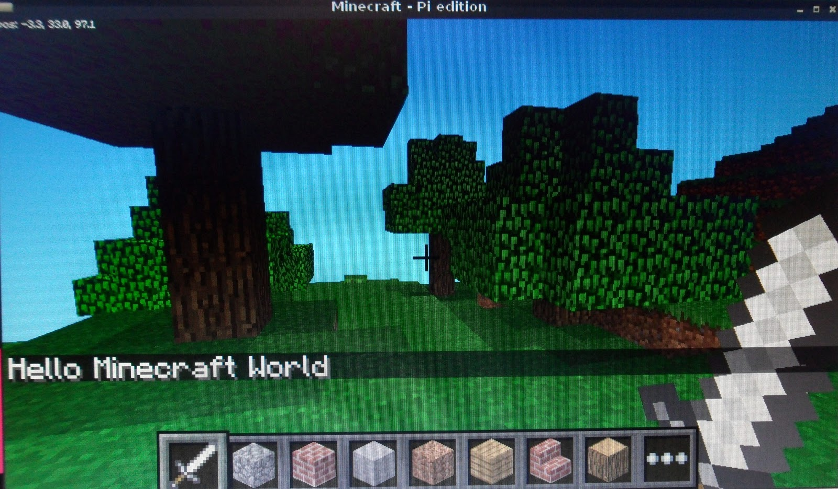
There I am!
( -3, 33, 97 )
Coordinates are shown in upper-left corner on screen.

Slide 36
Get Position
You can get Steve’s position and display it in Python.
Let’s try it now. Open a new file and enter this:
# Connect to Minecraft
from mcpi.minecraft import Minecraft
mc = Minecraft.create()
# Get the player's position and display it
pos = mc.player.getPos()
print pos.x, pos.y, pos.z
Move Steve around and re-run the code (use setPos())

Slide 37
Teleporting
Start a new Python window by clicking ‘File’ and ‘New’. Click in this new window and type this code.
import mcpi.minecraft as minecraft
import time
mc = minecraft.Minecraft.create()
time.sleep(1)
pos = mc.player.getPos()
mc.postToChat(“You are located x=“ +str(pos.x) + “,
y=“ +str(pos.y) +”, z=“ +str(pos.z))
time.sleep(2)
mc.postToChat(“Get ready to fall from the sky!”)
time.sleep(5)
mc.player.setPos(pos.x, pos.y + 60, pos.z)
Click on File and save your code in your Pi ‘Documents’ folder as teleport.py
Run the code (press F5)

Slide 38
LAB TIME
Use the remainder of class to explore the teleport code. Try different values and see where Steve goes!
You can leave when you’re finished.
DO NOT DISTURB the other classes!
REMEMBER TO SHUTDOWN YOUR RASPBERRY PI
DO NOT POWER IT OFF UNTIL YOU SHUTDOWN

Slide 39
Questions or comments?

